Slide 1
Unit 1 My Day
五年级

Slide 2
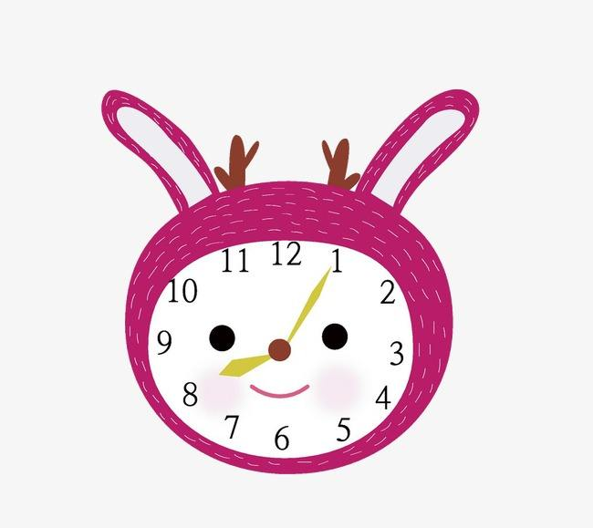
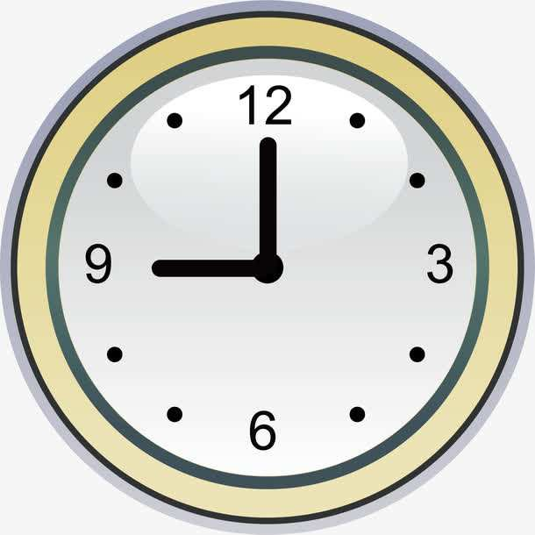
What time is it?
It’s ...

Slide 3
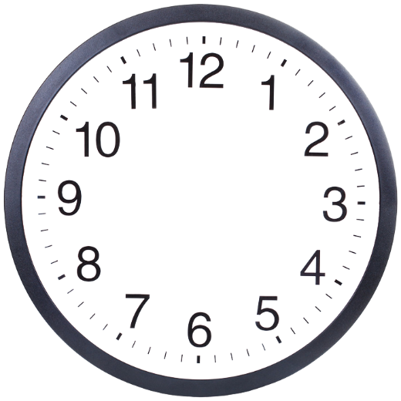
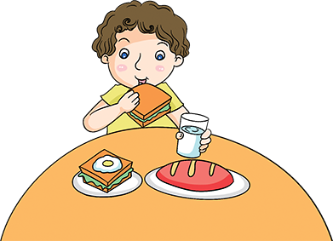
eat breakfast
It’s time for breakfast!
Let’s .
eat breakfast

Slide 4
eat lunch
It’s time for lunch!
Let’s .
eat lunch

Slide 5
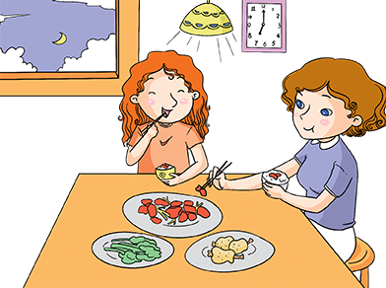
eat dinner
It’s time for dinner!
Let’s .
eat dinner

Slide 6
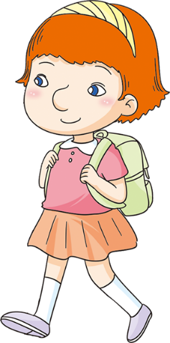
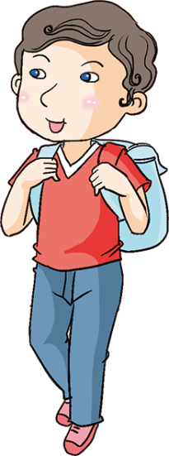
When do you ?
I go to school .
go to school
at 7:20

Slide 7
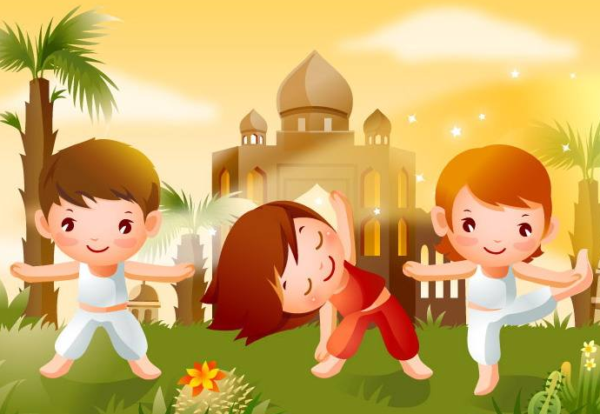
do morning exercises
早锻炼，做早操

Slide 8
When do you ?
I do morning exercises .
do morning exercises
at 8:00

Slide 9
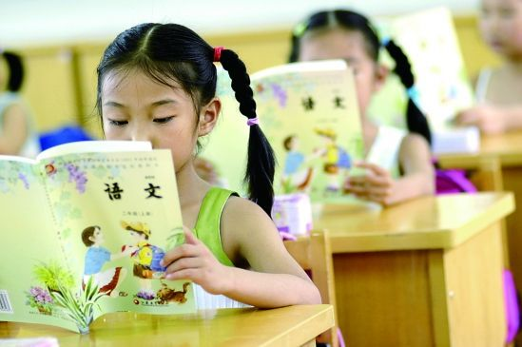
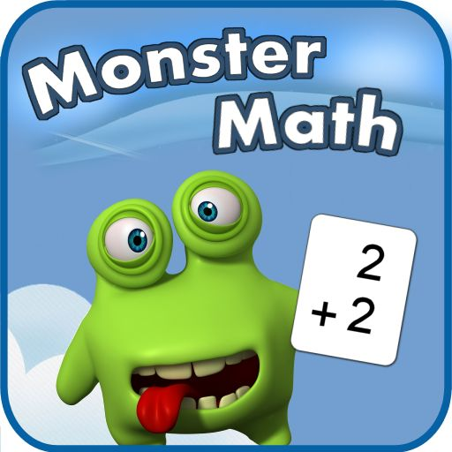
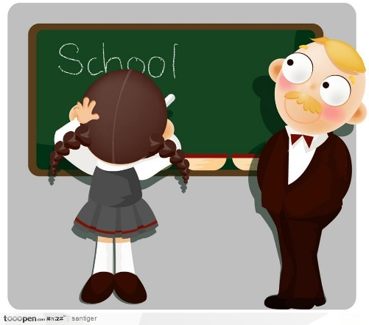
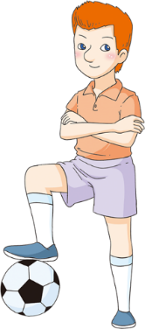
have a Chinese class
have a math class
have an English class
have a PE class

Slide 10
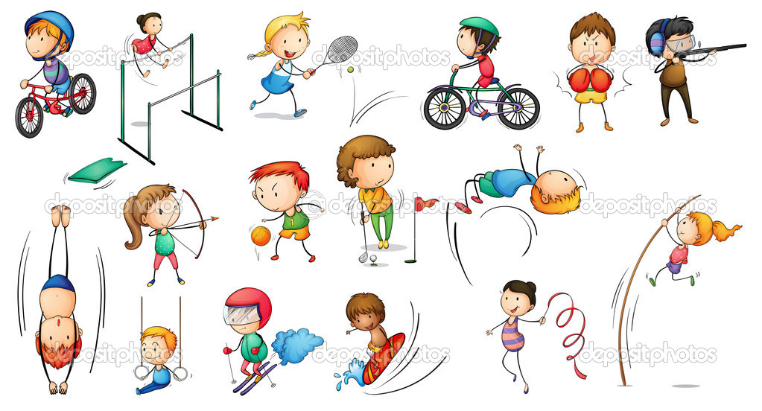
play sports
参加体育运动

Slide 11
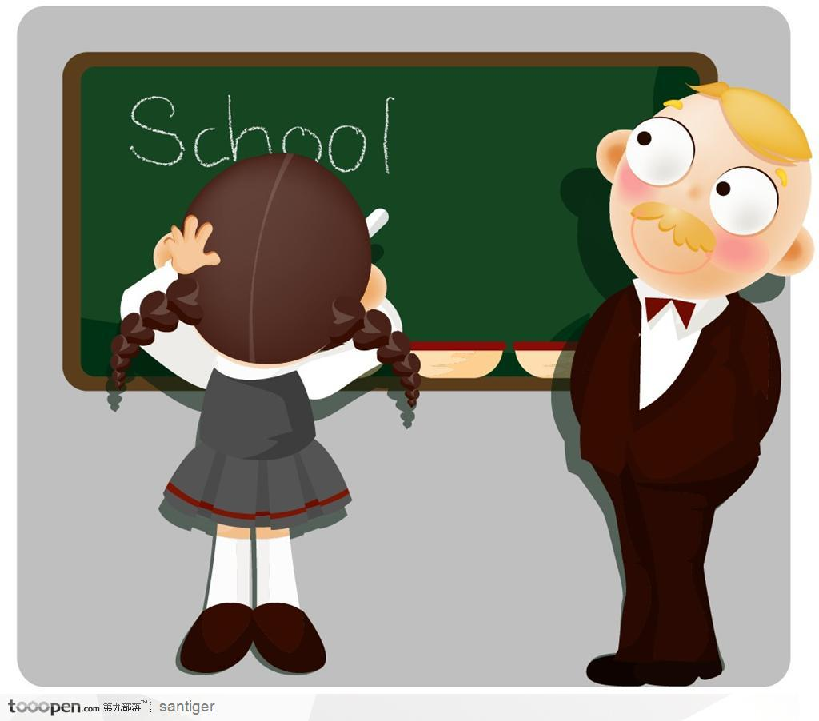
When do you ?
I have an English class ________.
have an English class
at 10:40

Slide 12
do morning exercises
eat breakfast
have … class
play sports
eat dinner

Slide 13
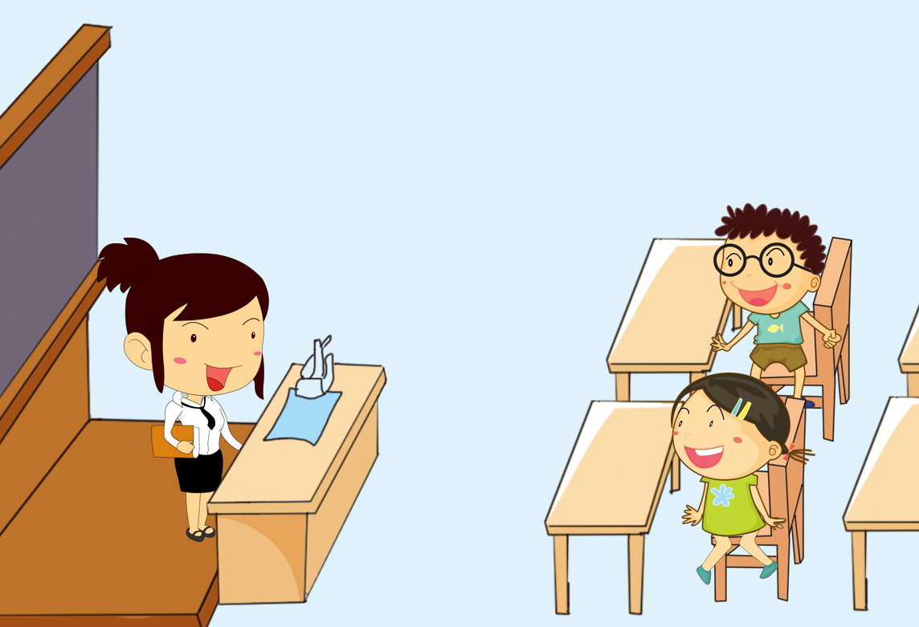
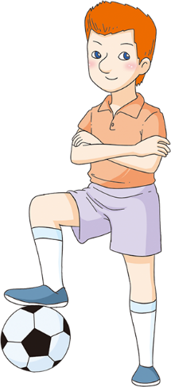
Let’s learn
do morning exercises
eat breakfast
have ... class
play sports
eat dinner

Slide 14
Look and match
do morning exercises
eat breakfast
have ... class
play sports
eat dinner
吃早饭
吃晚饭
做早操
上……课
进行体育运动

Slide 15
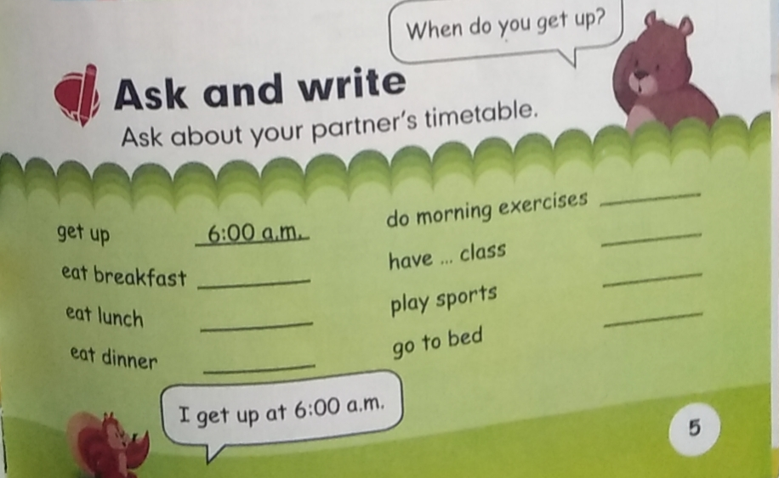
Ask and write

